Slide 1

Interfacing UART with LPC4088
DAY 18
EMBEDDED SYSTEM DESIGN & IoT-Master Class

Slide 2
What You will learn Today?
What is UART
How it works
UART Registers in LPC4088
Functions for UART Transmit and Receive Code

Slide 3
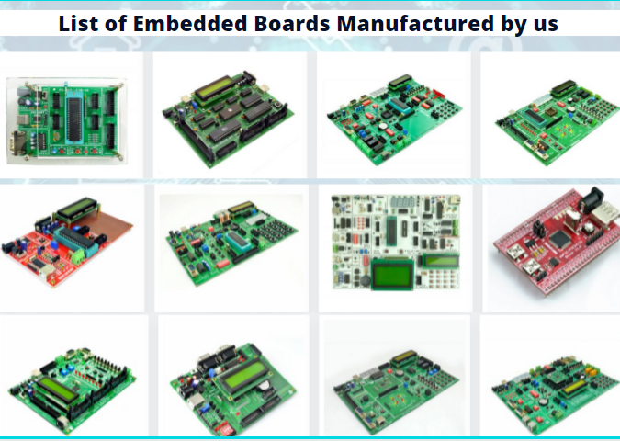
About Pantech
Started in the Year 2004
Lab equipments and Sensor Interface
Manufacturer of Brainsense EEG Headset
Reconfigurable Algorithms on AI
Manufacture of AI development Boards
Power electronics, Fuel cell and Renewable Energy trainers
www.pantechsolutions.net

Slide 4


About me
My Primary Expertise
Microcontroller Architecture: 8051,PIC,AVR,ARM,MSP430,PSOC3 DSP Architecture: Blackfin,C2000,C6000,21065L Sharc FPGA: Spartan,Virtex,Cyclone Image Processing Algorithms: Image/Scene Recognition, Machine Learning, Computer Vision, Deep Learning, Pattern Recognition, Object Classification ,Image Retrieval, Image enhancement and denoising. Neural Networks : SVM,RBF,BPN Cryptography :RSA,DES,3DES,Ellipti curve,Blowfish,Diffe Hellman Compilers: Keil,Visual DSP++,CCS, Xilinx Platform studio,ISE, Matlab, Open CV
https://www.linkedin.com/in/jeevarajan/
www.pantechsolutions.net

Slide 5
Announcement
Attendance Link at 9 pm
Minimum attendance required for an E-Certificate is 27 Days. Attendance link will be valid for 1 hrs. after the event.
For Internship Candidates no attendance required ,it will be accessed from the LMS Portal. (learn.pantechsolutions.net)
Recorded Video Streaming for LAB classes to improve Learning Experience
8051 – 5 Days workshop –use the same attendance form
support.pantechsolutions.net

Slide 6

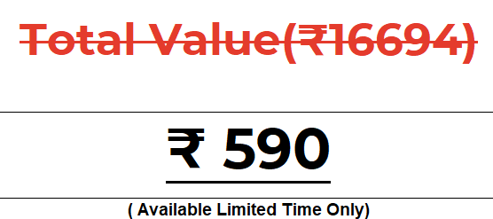
What you get on 30 Days Internship

Slide 7
Mindset Lesson for the Day
You Cannot Manage Time. You Can Only Manage Yourself .
Focus is the most Valuable asset not the time.

Slide 8
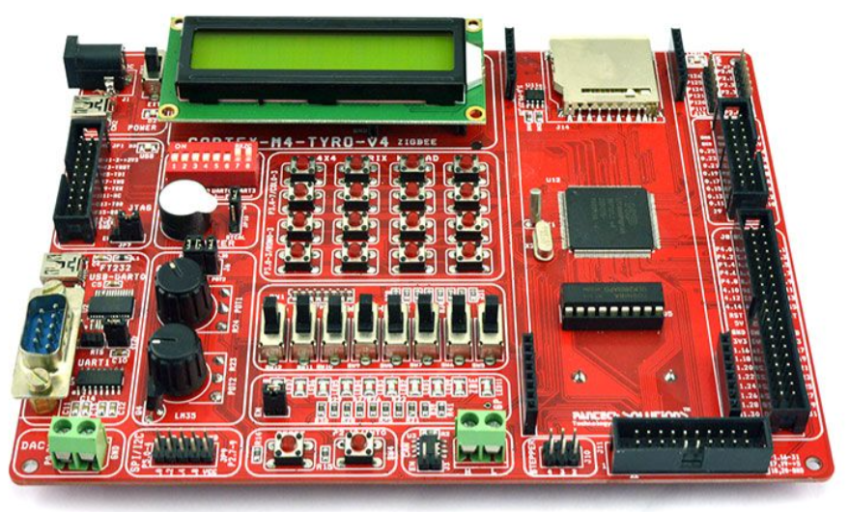
Embedded Sytem Design using Cortex M4-LPC4088

Slide 9
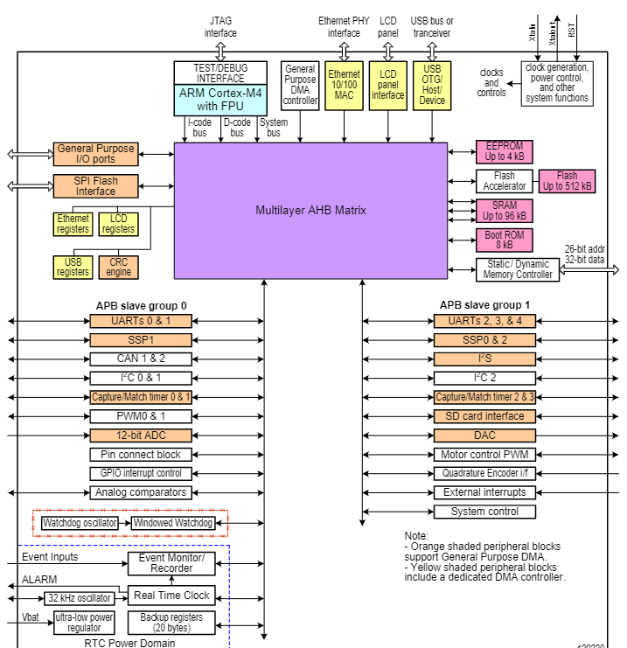
LPC4088 BLOCK DIAGRAM

Slide 10
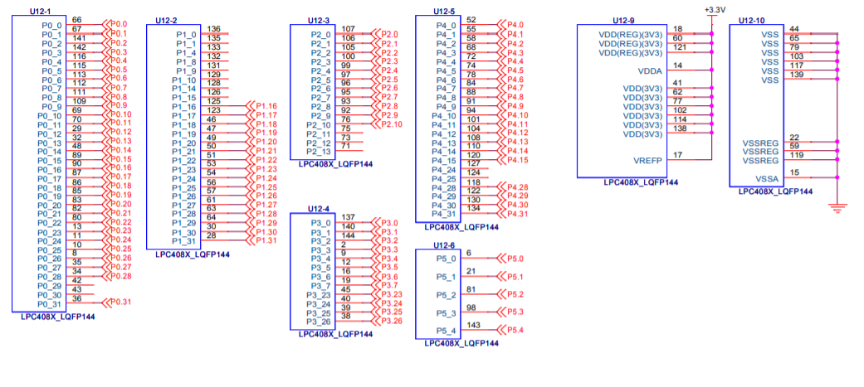
LPC4088

Slide 11
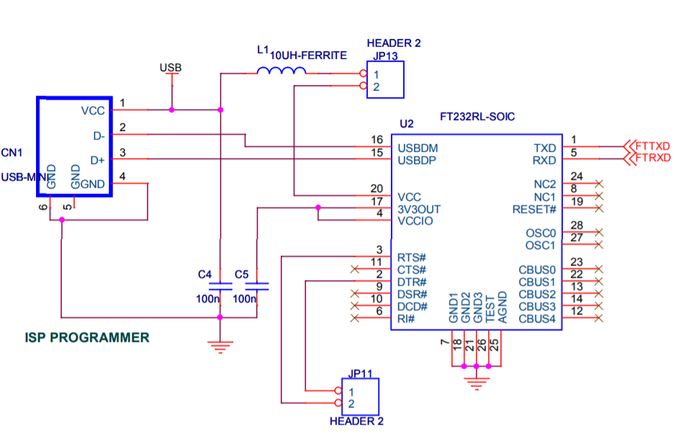
FT232 Interface and ISP Programming

Slide 12
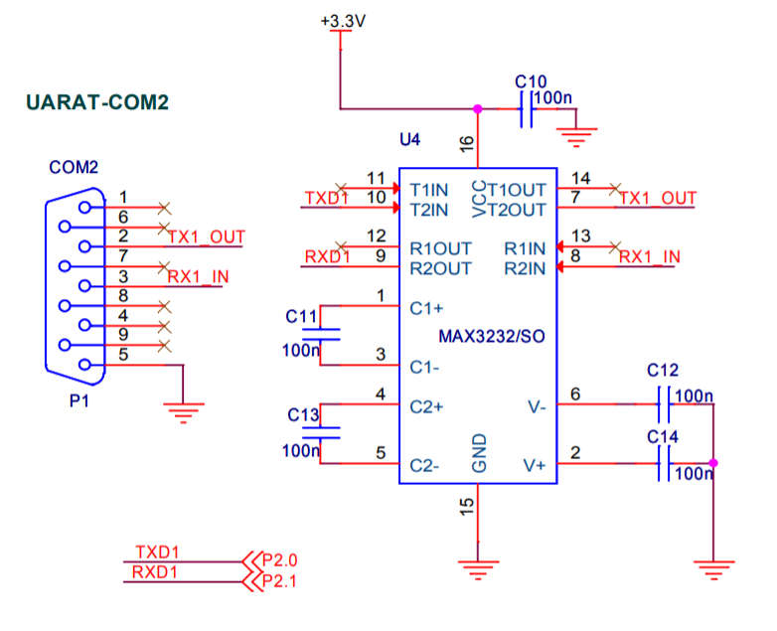
RS232 Interface

Slide 13
WHAT IS UART
Universal asynchronous receiver and Transmitter
Serial port, COM port, RS232, RS485
VERY COMMON AND SIMPLE
Useful for communication to
Microcontroller
Computer
Other FPGA

Slide 14
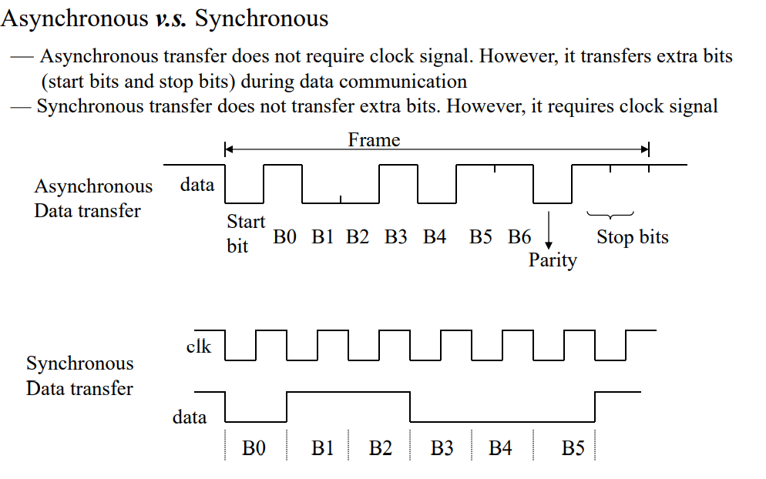
Asynchronous Vs Synchronous
Two methods of serial communication are
Synchronous Communication: Transfer of bulk data in the framed structure at a time
Asynchronous Communication: Transfer of a byte data in the framed structure at a time

Slide 15
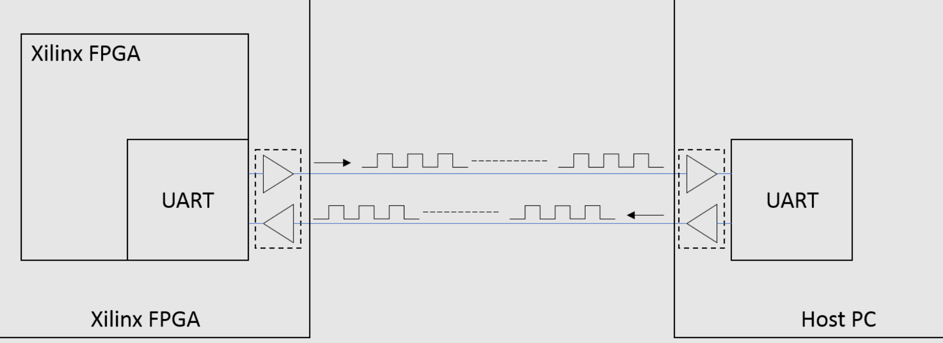
UART

Slide 16
UART PARAMETERS
Baud Rate (9600, 19200, 115200, others)
Number of Data Bits (7, 8)
Parity Bit (On, Off)
Stop Bits (0, 1, 2)
Flow Control (None, On, Hardware)

Slide 17
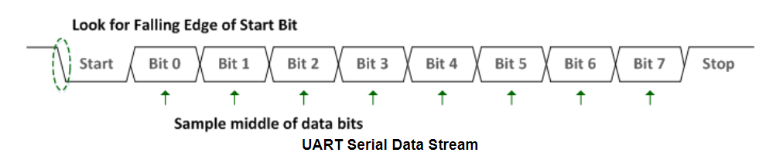
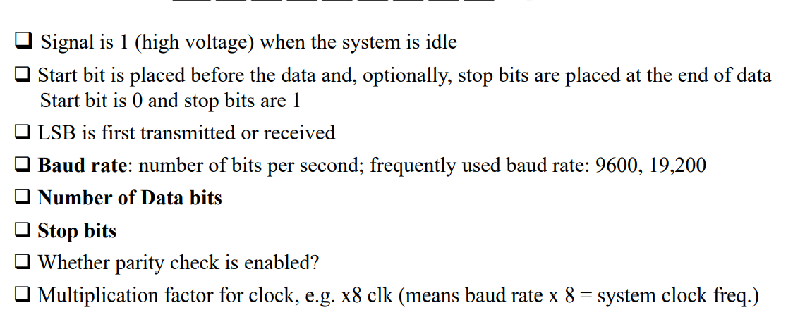
UART DATA STREAM EXAMPLE

Slide 18
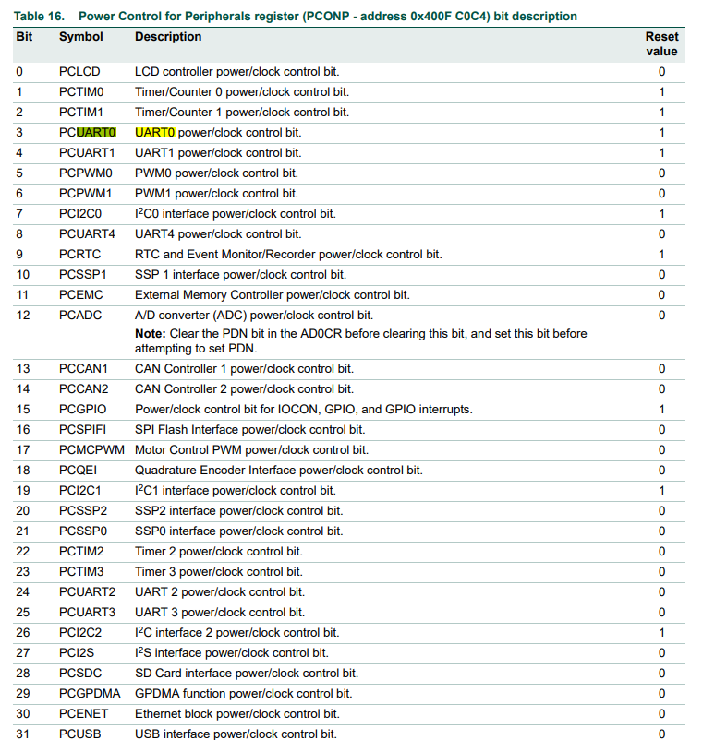
Step 1- Enable power to UART0 –page 30
LPC_SC->PCONP |= (1 << 3);

Slide 19
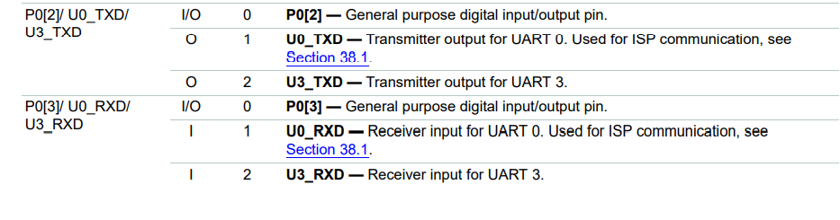
Step 2-2. Configure pins P0.2 and P0.3 as UART0 TX and RX –Page 99
LPC_IOCON->P0_2 |= 1;
LPC_IOCON->P0_3 |= 1;

Slide 20
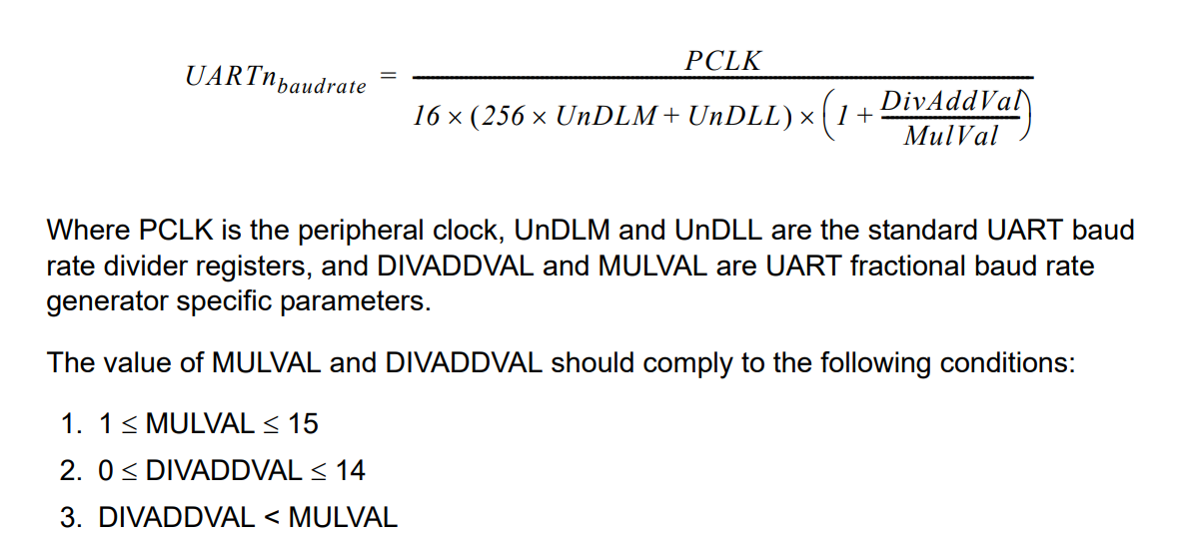
STEP 3 -UART BAUD RATE CALCULATION

Slide 21
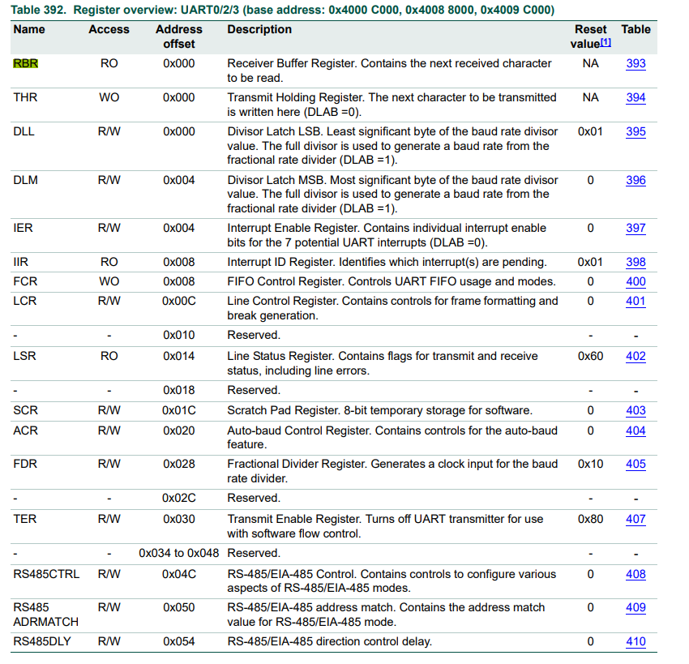
STEP 4 -SELECT CLOCK SOURCE –PG 492-495

Slide 22
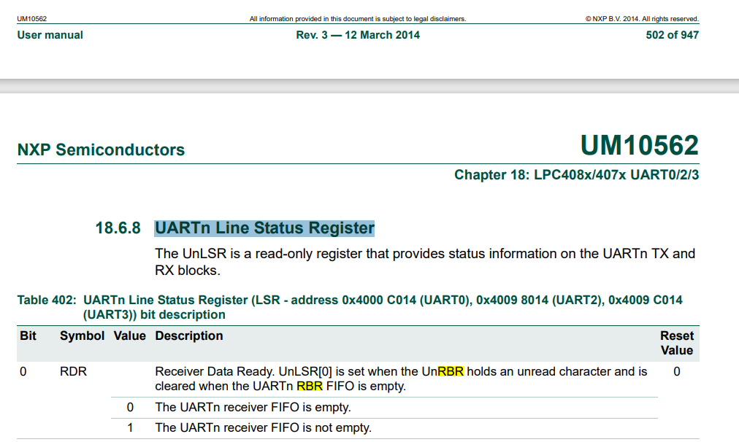
LSR

Slide 23
Header File and Declaration
#include "LPC407x_8x_177x_8x.h"
unsigned char recval=0, welstring[]="Hi: Press a Key\r\n";
unsigned char UART0_Receive(void);
void UART0_Txmt(unsigned char Chr);
void init_serial(void);
void UART0_puts(unsigned char *string);

Slide 24
Uart Initialization
void init_serial(void)
{
//1. set bit PCUART0
LPC_SC->PCONP |= (1 << 3); /* enable power to UART0*/
//2. Configure pins P0.2 and P0.3 as UART0 TX and RX
LPC_IOCON->P0_2 |= 1; /* Pin P0.2 used as TXD0 */
LPC_IOCON->P0_3 |= 1; /* Pin P0.3 used as RXD0 */
//3.Select Clock source and frequency=PCLK ie 30MHz
/* 8 bits, no Parity, 1 Stop bit */
// Set DLAB=1 to access baud rate Register
LPC_UART0->LCR = 0x83;
//4. Derive baud rate from the UART clock source,
//DLM:DLL=PCLK/(16*baud)= 30Mhz/(16*9600)= 195
LPC_UART0->DLL = 195; /* 9600 Baud Rate @ 30.0 MHZ PCLK*/
LPC_UART0->DLM = 0; /* MSB = 0 */
LPC_UART0->LCR = 0x03; /* DLAB = 0*/
}

Slide 25
Receive a character
//Receive a character
unsigned char UART0_Receive(void)
{
//7.Check the Receiver flag for data ready
// and Read the character
while((LPC_UART0->LSR & 0x01)==0);
return(LPC_UART0->RBR);
}

Slide 26
Transmit a character
//Transmit a character
void UART0_Txmt(unsigned char Chr)
{
//6. Check the Transmitter flag
// If it is High Transmit a character
while((LPC_UART0->LSR & 0x20)==0);
LPC_UART0->THR = Chr;
}

Slide 27
Transmit a string
//Transmit a string
void UART0_puts(unsigned char *string)
{
while(*string)
UART0_Txmt(*string++);
}

Slide 28
Thank You

